Slide 1
ProMax Websites
Providing cutting edge technology and
a seamless integration with ProMax

Slide 2
Importance of having a great website
In years past the average person visited 5-6 dealerships before buying a vehicle. That average has now dropped to fewer than 2. Why is this? Because people are doing all their research online.
This shift in customer behavior highlights the importance of having a robust website that is capable of handling multiple device platforms, is beautifully designed yet still simple to navigate, helps inform your visitors and entices lead generation all while being easy to manage and maintain from anywhere!
With ProMax Websites, we’ve made it our top priority to ensure each website is built for success all while keeping the individual dealership’s design needs in mind.

Slide 3
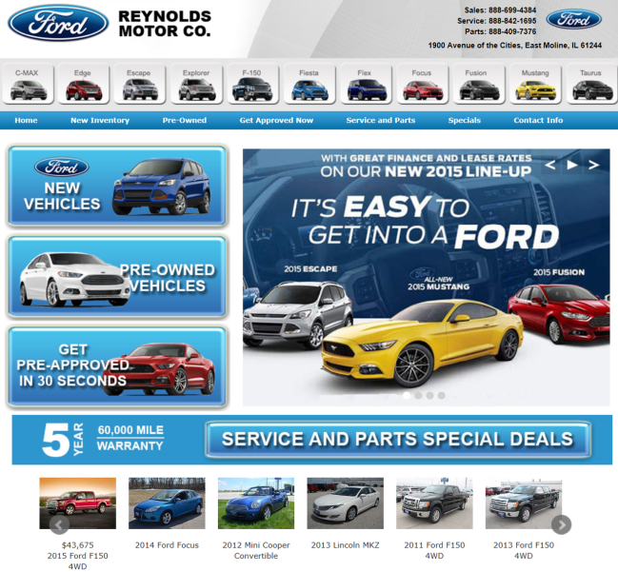
Custom designed specifically for your dealership
One of the most important aspects of keeping customers engaged on your site and getting them to return is by having a professionally designed website which is easy to navigate.
Each dealership receives a custom designed website along with direct one-on-one access to one of our highly talented design team members. Our designers work directly for us and strive to incorporate your specific design thoughts into a great looking and functional website.

Slide 4
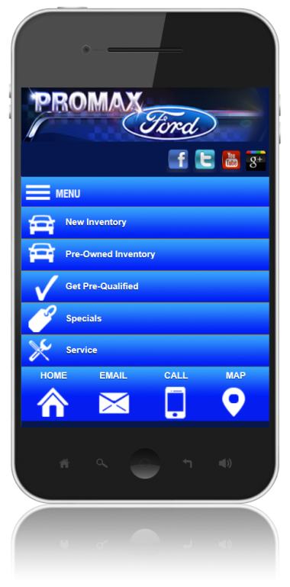
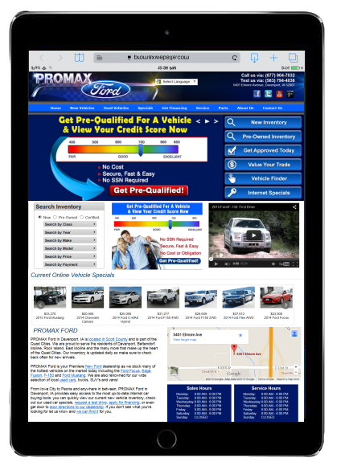
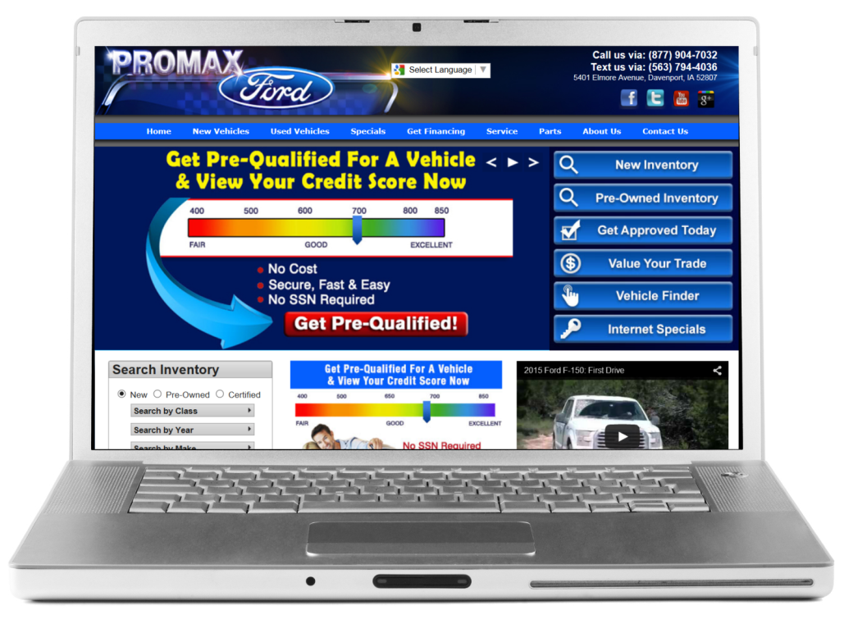
Responsive design for mobile
Every year more and more people are using mobile devices when searching for a vehicle online. So having a website which functions just as well, if not better, on a mobile device as on a desktop is crucial, now more than ever.
All our websites are built utilizing responsive mobile design. This will ensure that no matter what the device, whether desktop, tablet, or smartphone, your customers will have a great experience when browsing on your new website.

Slide 5
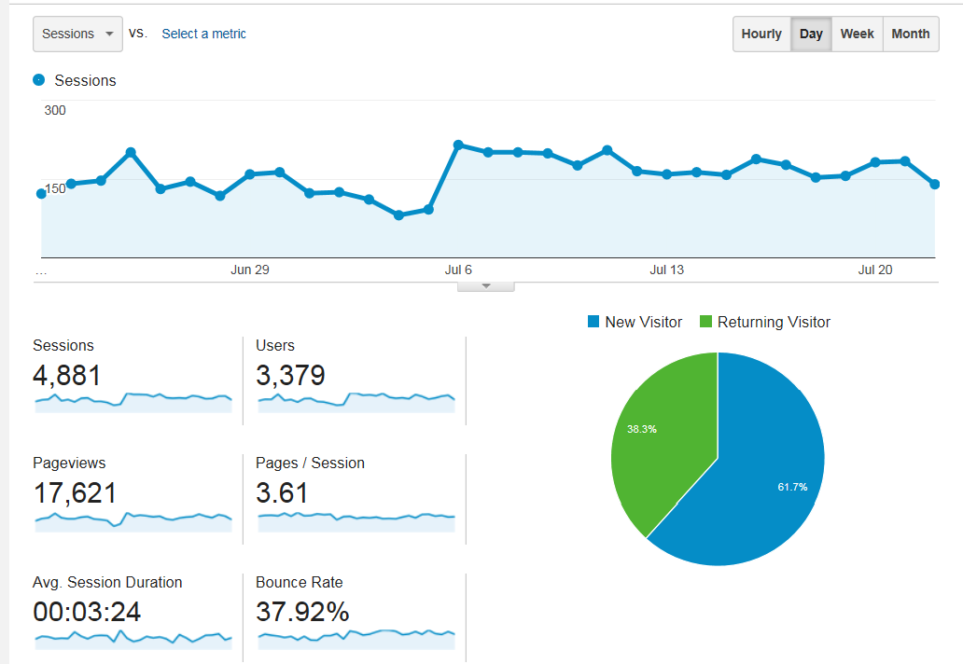
What good is a website if it’s not built for effective SEO?
Including your website in all possible advertising is a great start but it can’t be your sole method of driving traffic to your site. You must have a website that is going to come up organically in customers’ search engine results too!
Because of this, we adhere to the guidelines set forth by Google on maintaining strong SEO-centric sites. This is followed up via regular internal review, tweaking, and testing. We even allow you, the dealership, the ability to monitor and control key SEO items such as page titles, page descriptions, links, and page content in order to help maximize organic SEO effectiveness.

Slide 6
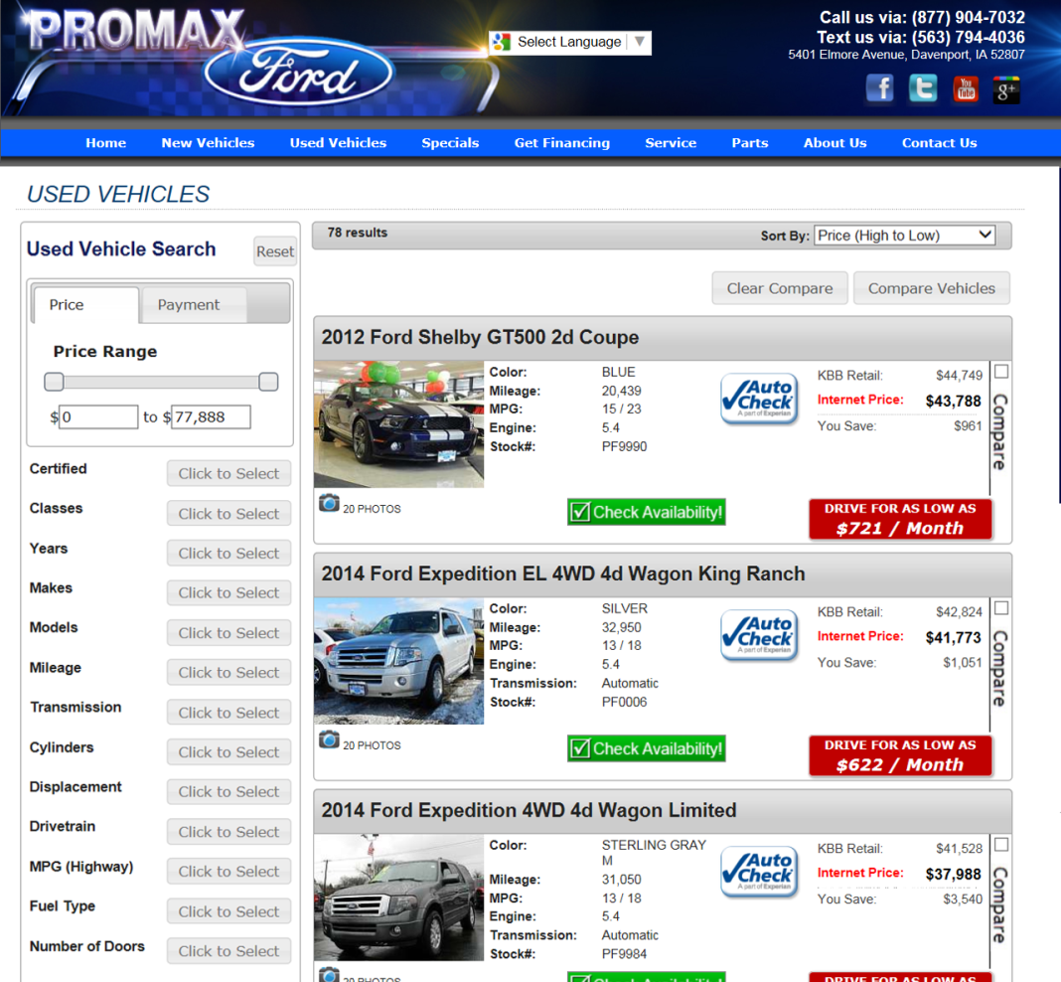
Inventory search & display – After all, isn’t this why most people are on your website?
As you well know, a majority of your website visitors are interested in seeing what you currently have in stock. So having an intuitive and informative inventory search is key in order to build visitor retention and engagement.
Studies have shown that a majority of visitors are ‘payment’ buyers. Our websites provide visitors the option to search for their next vehicle by payment via our state of the art inventory search module and other advanced search filters.

Slide 7
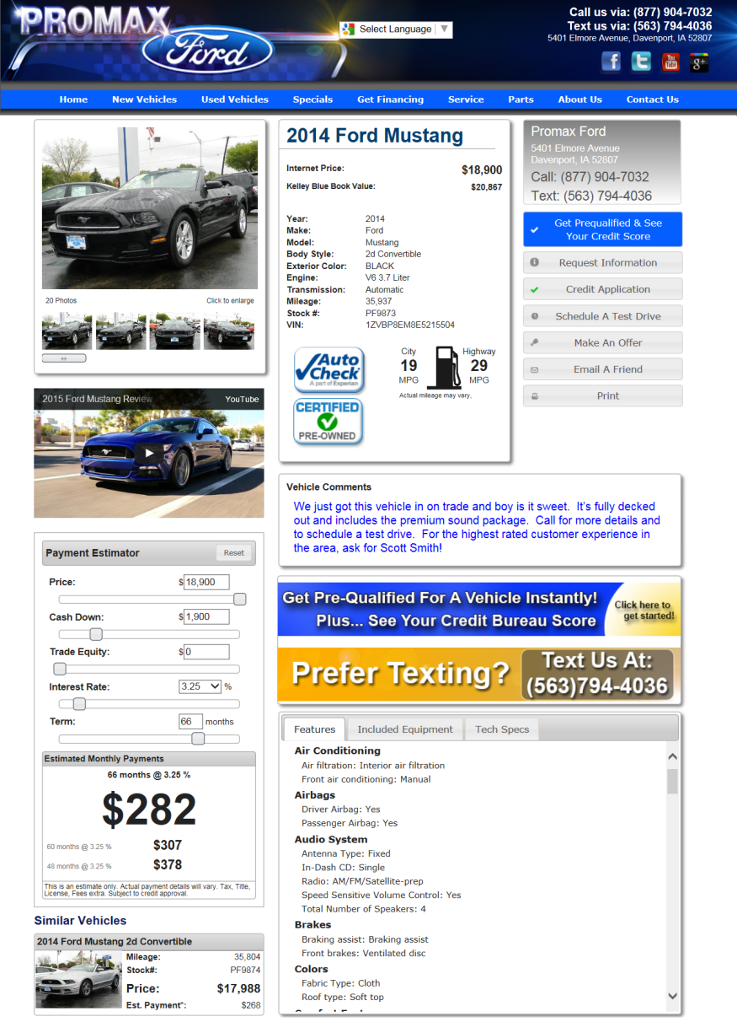
Vehicle Detail Page
Our vehicle detail page has been designed to maximize the amount of important information readily available and to help directly engage your visitors on a personal level.
Specifically, this page highlights multiple payment ranges and invites your customers to adjust payment-oriented items such as price, down payment, term, and interest rate on the fly.
This type of interaction is engineered to give customers mental ownership of the vehicle, which drastically increases the chance of them filling out a form, calling, or stopping in for a test drive.

Slide 8
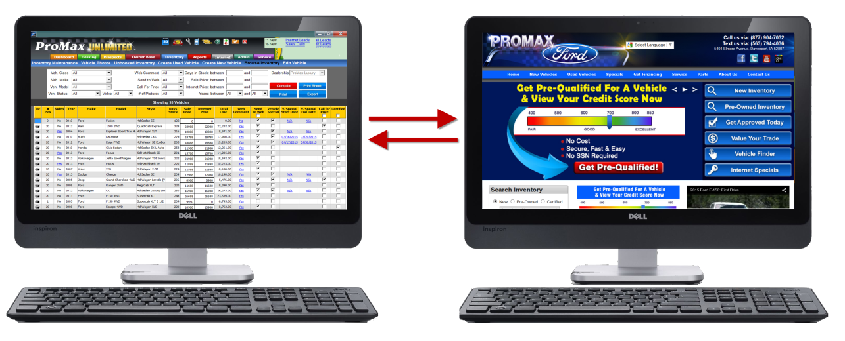
Integration with ProMax – making your job easier and more efficient
Your website is a fluid entity. If you set it up and leave it, you won’t see the results needed to stay competitive.
We understand this concern and that is why we spent so much time ensuring that your website can be managed directly through the integration with ProMax. The days of maintaining multiple systems can be a thing of the past.
In the next few screens you will see just how easy it is for you to manage every aspect of your website.

Slide 9
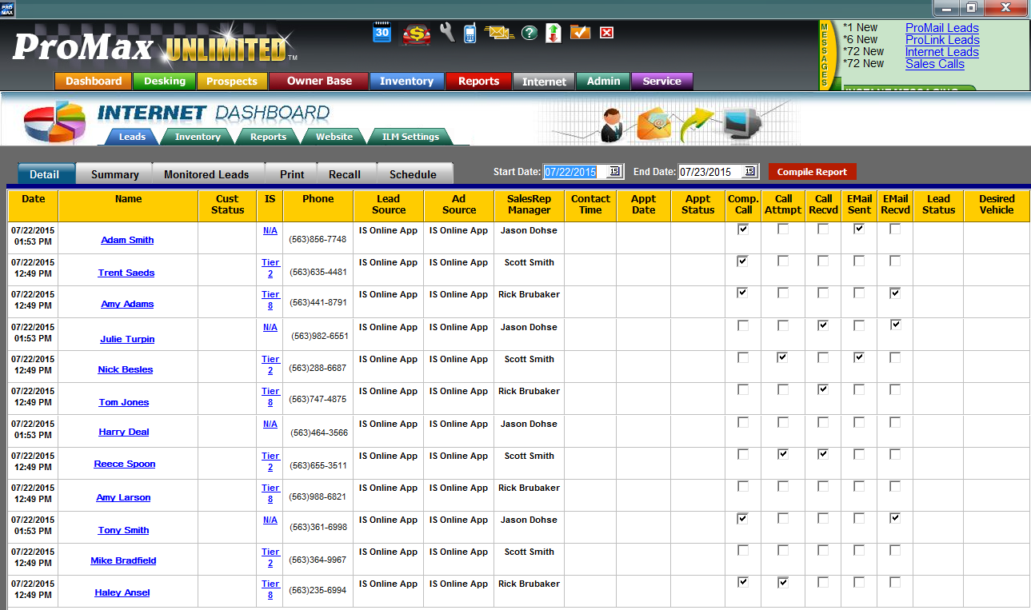
Managing website leads through ProMax
All leads generated from the website will be imported directly into your ProMax system in real time. You will be notified immediately of any new lead via the message center, email, or even text notification.
Within ProMax, you will have access to a separate prospect log geared specifically towards reviewing and handling internet leads. There are many CRM/ILM features available within ProMax providing you the necessary tools to effectively work every new lead as you see fit.

Slide 10
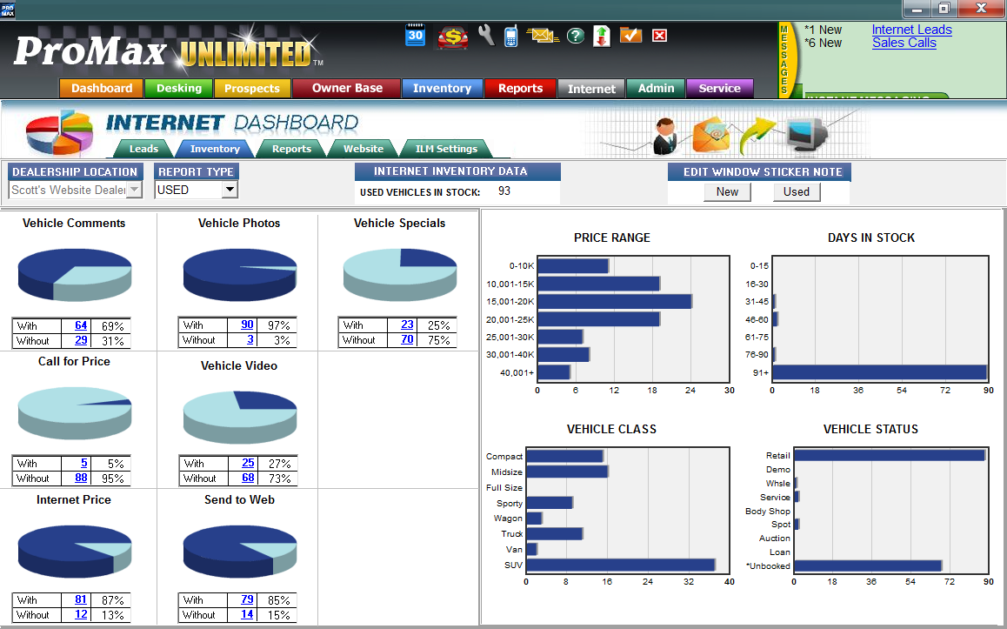
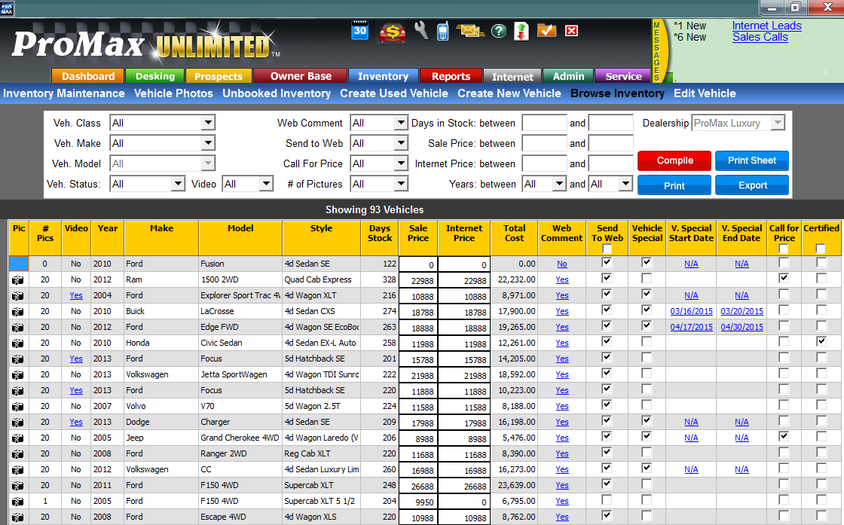
Managing your inventory through ProMax
Having accurate and up to date inventory on your website is extremely important.
Your website inventory will be automatically updated directly from ProMax. No more having to maintain your inventory in multiple systems. We also provide multiple prebuilt inventory reports that are used specifically for managing your website inventory.
As part of our website package we will also automatically export your inventory to your 3rd party sites such as Autotrader, Cars.com, etc.

Slide 11
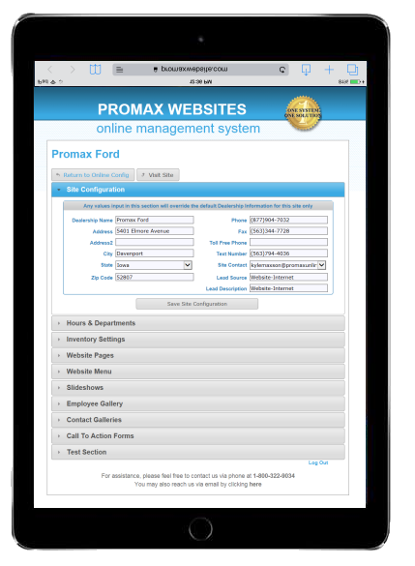
Manage your website’s display, functionality, and content through ProMax
As mentioned earlier, it is important to make sure you are continually updating and managing your website. Each website includes a state of the art back end management tool.
This tool can be accessed directly from within ProMax. It allows you to build new pages, edit existing pages, create new lead forms, change processes on your site, plus much more. All changes are done in real time to your site.

Slide 12
Summary
Custom designed sites
Built and maintained for effective SEO
Responsive mobile design
Great inventory search & display
Allows customer to search by monthly payment (can be turned off)
Full integration with ProMax
Robust and state of the art back end website management tool
Export inventory to 3rd party sites
No term commitment
Plus much more

Slide 13
ProMax Websites
Providing your dealership a state of the art website that gives your customers the experience and information they desire.
Seamlessly integrated with ProMax, streamlining everything into one system.
Dealer Marketing Services, Inc.
Makers of ProMax Unlimited
563-344-7610

